Slide 1
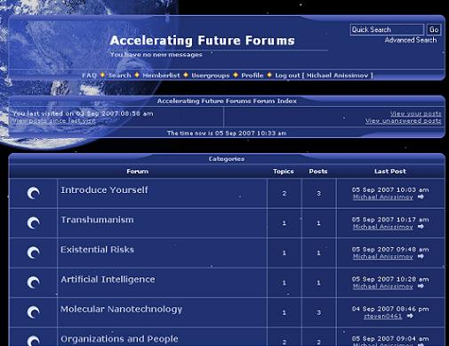
Internet forums

Slide 2

What is an internet forums? An Internet forum is a web application for holding discussions and posting user generated content. Internet forums are also commonly referred to as Web forums, message boards, discussion boards, (electronic) discussion groups, discussion forums, bulletin boards, fora (the Latin plural) or simply forums

Slide 3
Administrators A forum administrator typically has the ability to edit, delete, move or otherwise modify any thread on the forum. Administrators also usually have the ability to close the board, change major software items, change global skins, modify the board, and ban, delete, or create members.

Slide 4
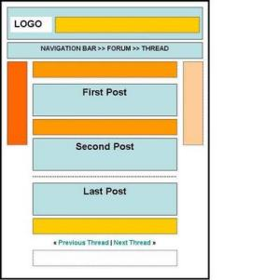
Moderators Moderators have a subset of these powers, which may include editing, deleting, and moving threads, mass pruning, warning members for offences, and changing minor forum details. It is often possible for moderator privileges to be delegated to other forum members.

Slide 5
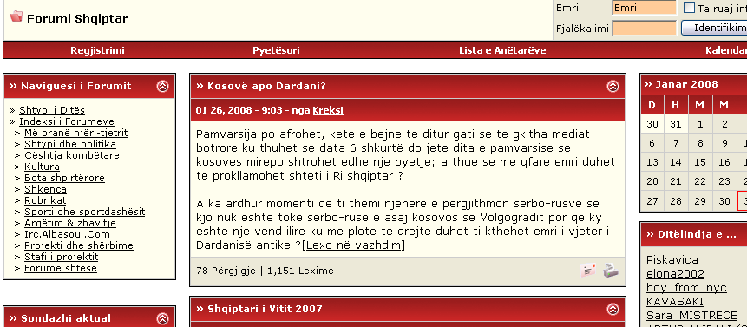
Albanian forums

Slide 6
Besart hasani

